Slide 1
How can Big Mountain Resort increase revenue by $1.75m this season?

Slide 2
Recommended Actions:
1: Increase ticket price by at least $5
AND
Either 2a: Add run, chair lift, increase vertical drop, and increase ticket price by additional $2
Or 2b:
Close 1, 2, or 5 runs

Slide 3
1: Ticket Price
Model suggested resort could support ticket increase of $15, but with an error of +/- $10
Large error may be result of including both high-end and mass-market resorts in data
Even if data was skewed by high-end resorts, $5 increase in ticket price should be reasonable

Slide 4
2a: Opening Additional Run
Model suggests plan to add run and increase vertical drop can support additional $2 increase to ticket price
Additional 4 acres guaranteed snow coverage or increasing length of longest run by 0.2mi not enough to significantly impact ticket price

Slide 5
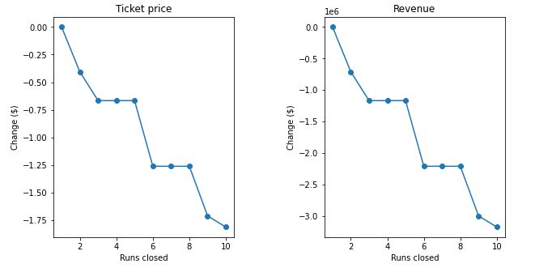
2b: Closing Runs

Slide 6
2b: Closing Runs (continued)
Closing 1 run has minimal decrease to revenue
2 runs decrease supportable ticket price and revenue
3 runs have the same impact as 4 or 5. If you have to close 3 or 4, you may as well save on maintenance and close 5
Closing 6 or more runs causes sharp drop in ticket price and revenue, not recommended

Slide 7
Summary
Can safely increase ticket price by $7 by implementing plans 1 and 2a
Can safely increase ticket price by $5 or less depending on number of runs closed by implementing plans 1 and 2b
Either way should increase net revenue

